Slide 1




NEXT GEN EMPLOYABILITY PROGRAM
Creating a future-ready workforce
Team Members
College Name
Student Name : Pathanjali Cinnakonda Janardhanan
Student ID : au814721104038
SRMTRPEC

Slide 2

CAPSTONE PROJECT SHOWCASE
Project Title
Notes Sharing Web Application using Django Framework
Abstract | Problem Statement | Project Overview | Proposed Solution | Technology Used | Modelling & Results | Conclusion

Slide 3
Abstract
In this project, we aim to develop a secure and efficient file-sharing web application using Django, a high-level Python web framework. The web app will allow users to upload, download, and manage files in a collaborative environment. Key features include user authentication, file management, and access control.

Slide 4
Problem Statement
Using third-party file transfer systems can provide convenient solutions for sharing files, but they also come with potential problems and considerations. Here are common challenges associated with relying on third-party file transfer systems:
Security Concerns
Reliability and Availability
Limited Customization and Control

Slide 5
Project Overview
The goal of this project is to develop a secure and efficient web application for file transfer, focusing on user privacy, data security, and seamless user experience. The application will allow users to securely upload, manage, and share files with enhanced features tailored for optimized file transfer workflows.
File Upload and Management
Secure File Transfer
Access Control and Permissions

Slide 6
Proposed Solution
.
To address the requirements and challenges outlined, we propose developing a secure file transfer web application using a technology stack centered around HTML, CSS, JavaScript, Python, and Django. This solution will emphasize security, user experience, and scalability to provide a robust platform for file management and secure sharing.
User Authentication and Authorization
User Interface (UI) and Experience
Secure File Transfer
File Upload and Management
Access Control and Sharing:

Slide 7


Technology Used
Front-end
Back-end

Slide 8
Modelling & Results
For the students and teacher there is an login and sign up page this will be the landing page of
this webapp and there are some validation process such as user name , password and after
the login there comes home page where students loged in can see and download
the files shared bythe teachers and when the teacher logs in he/she will have options to upload
a file when the user name and password does not matches web page shows no access
When there is some error it shows 404 page not found

Slide 9
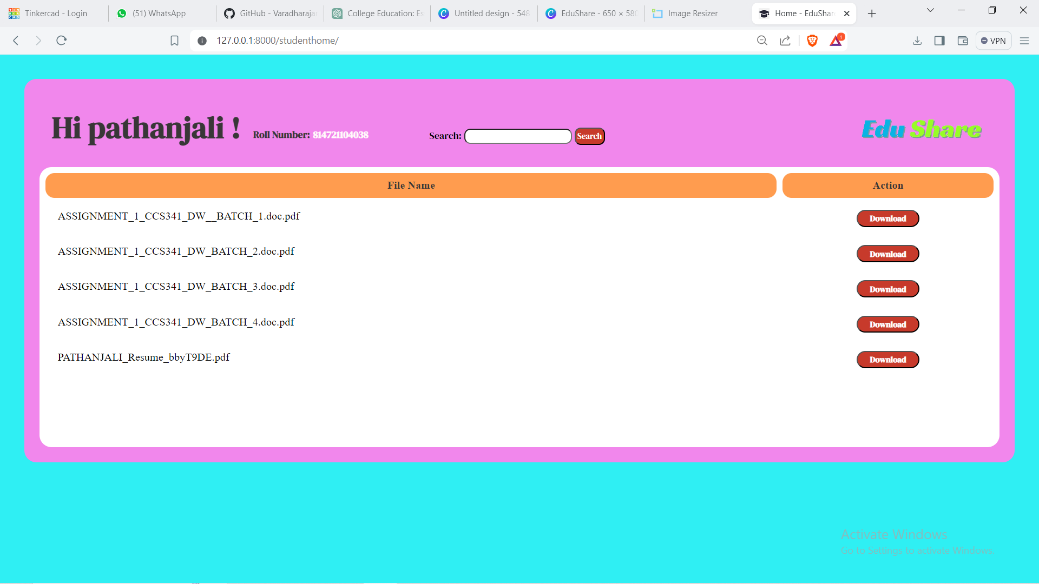
Homepage

Slide 10
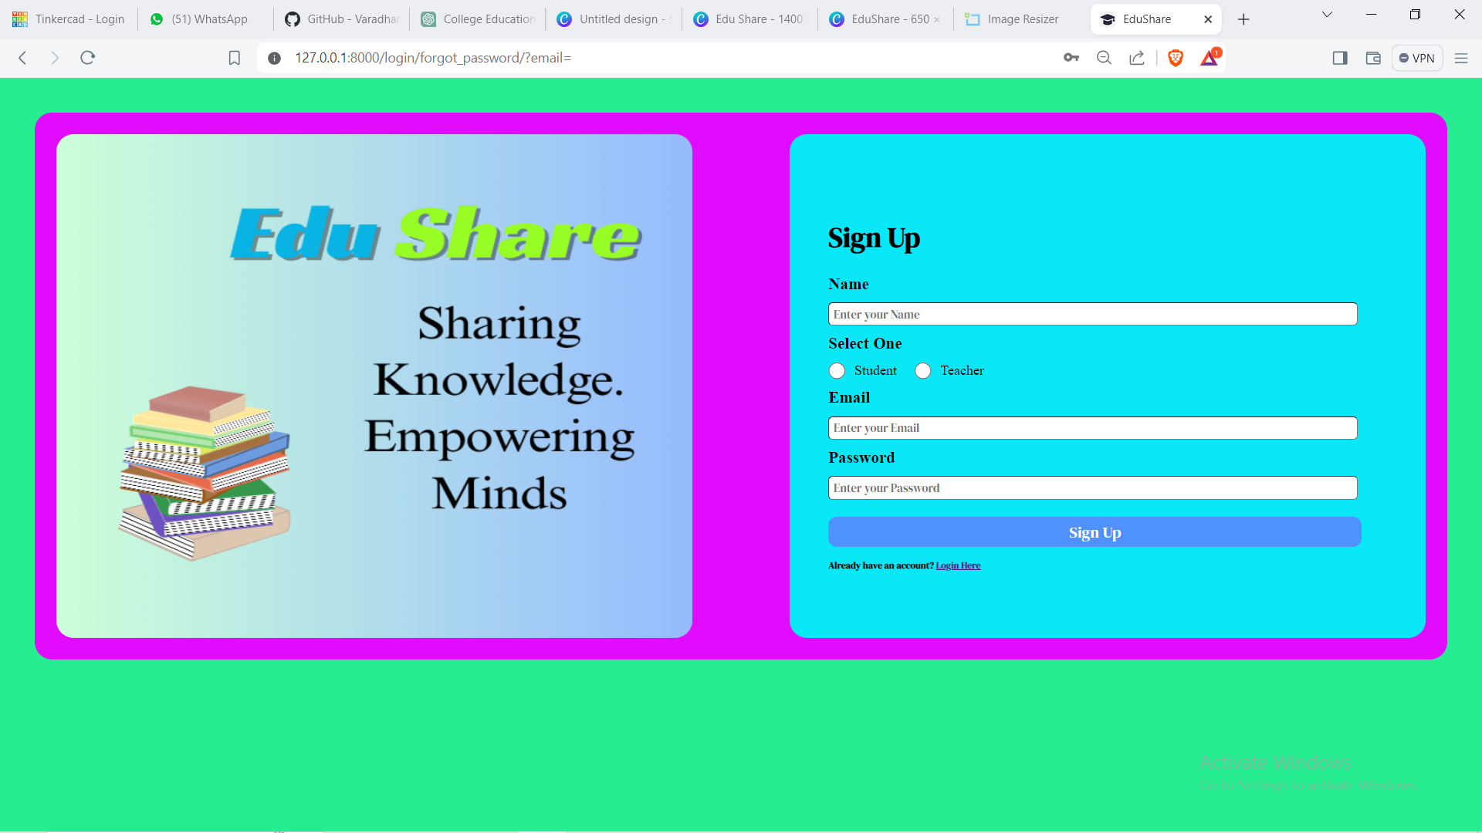
Sign up page

Slide 11
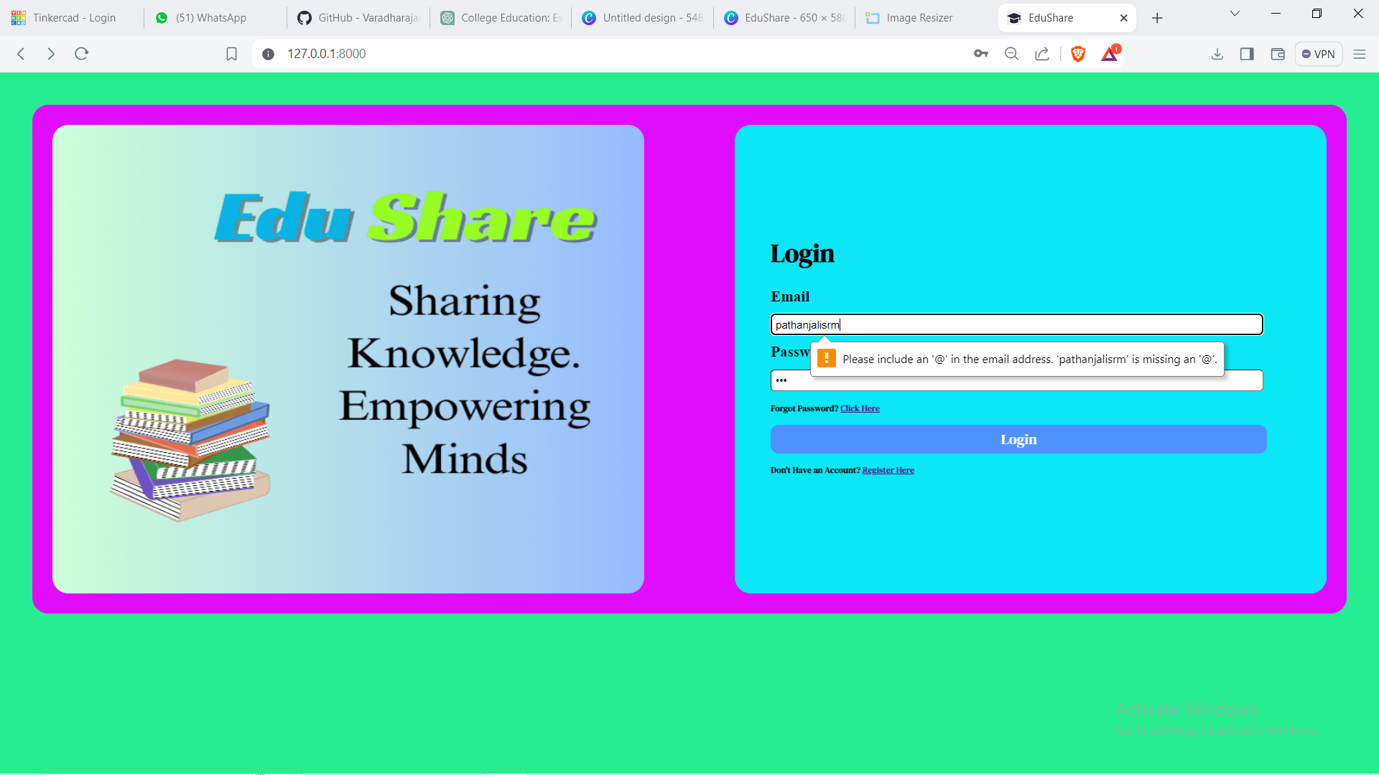
Login page

Slide 12
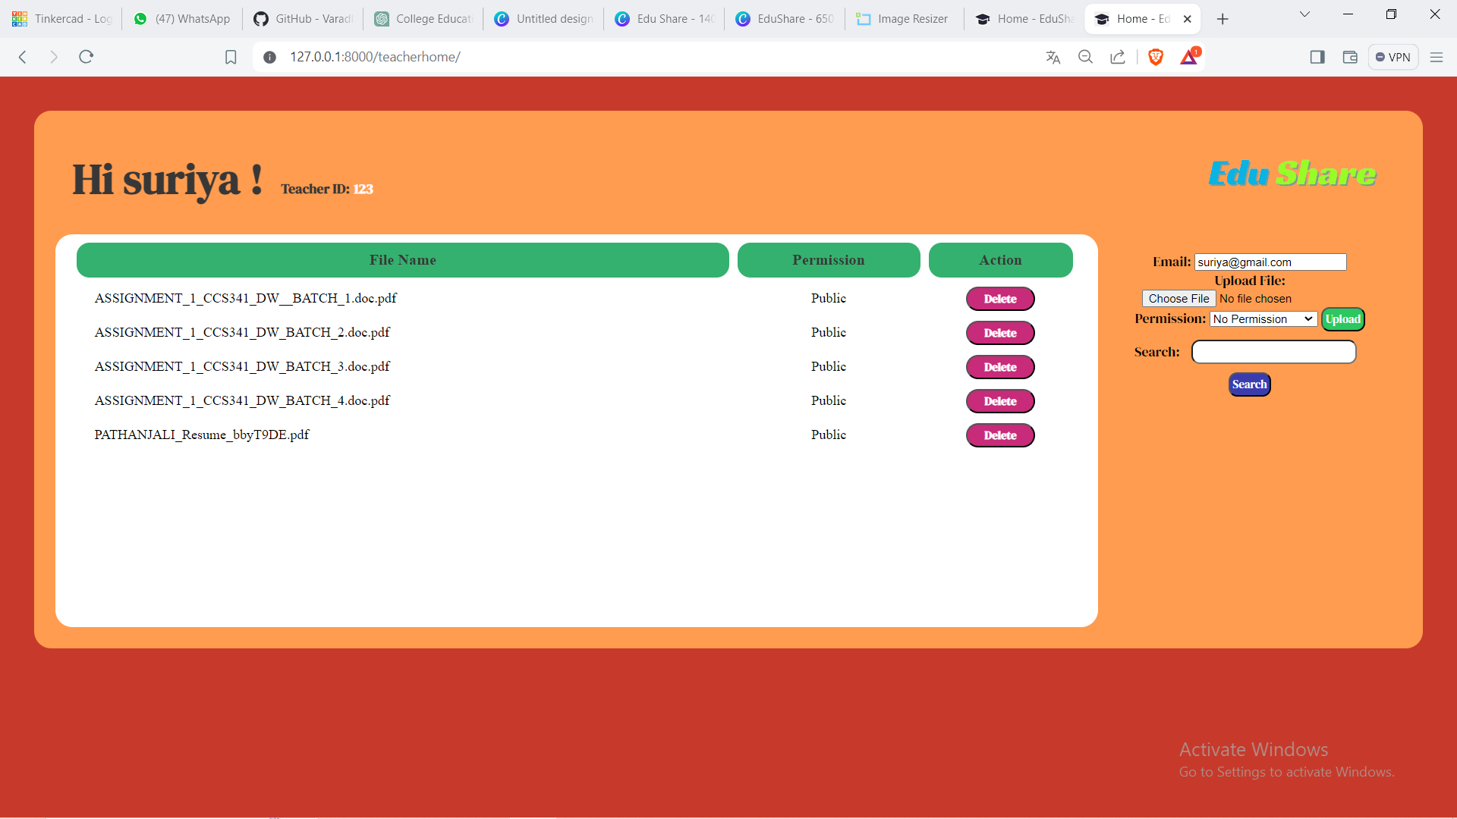
Teachers Home Page

Slide 13
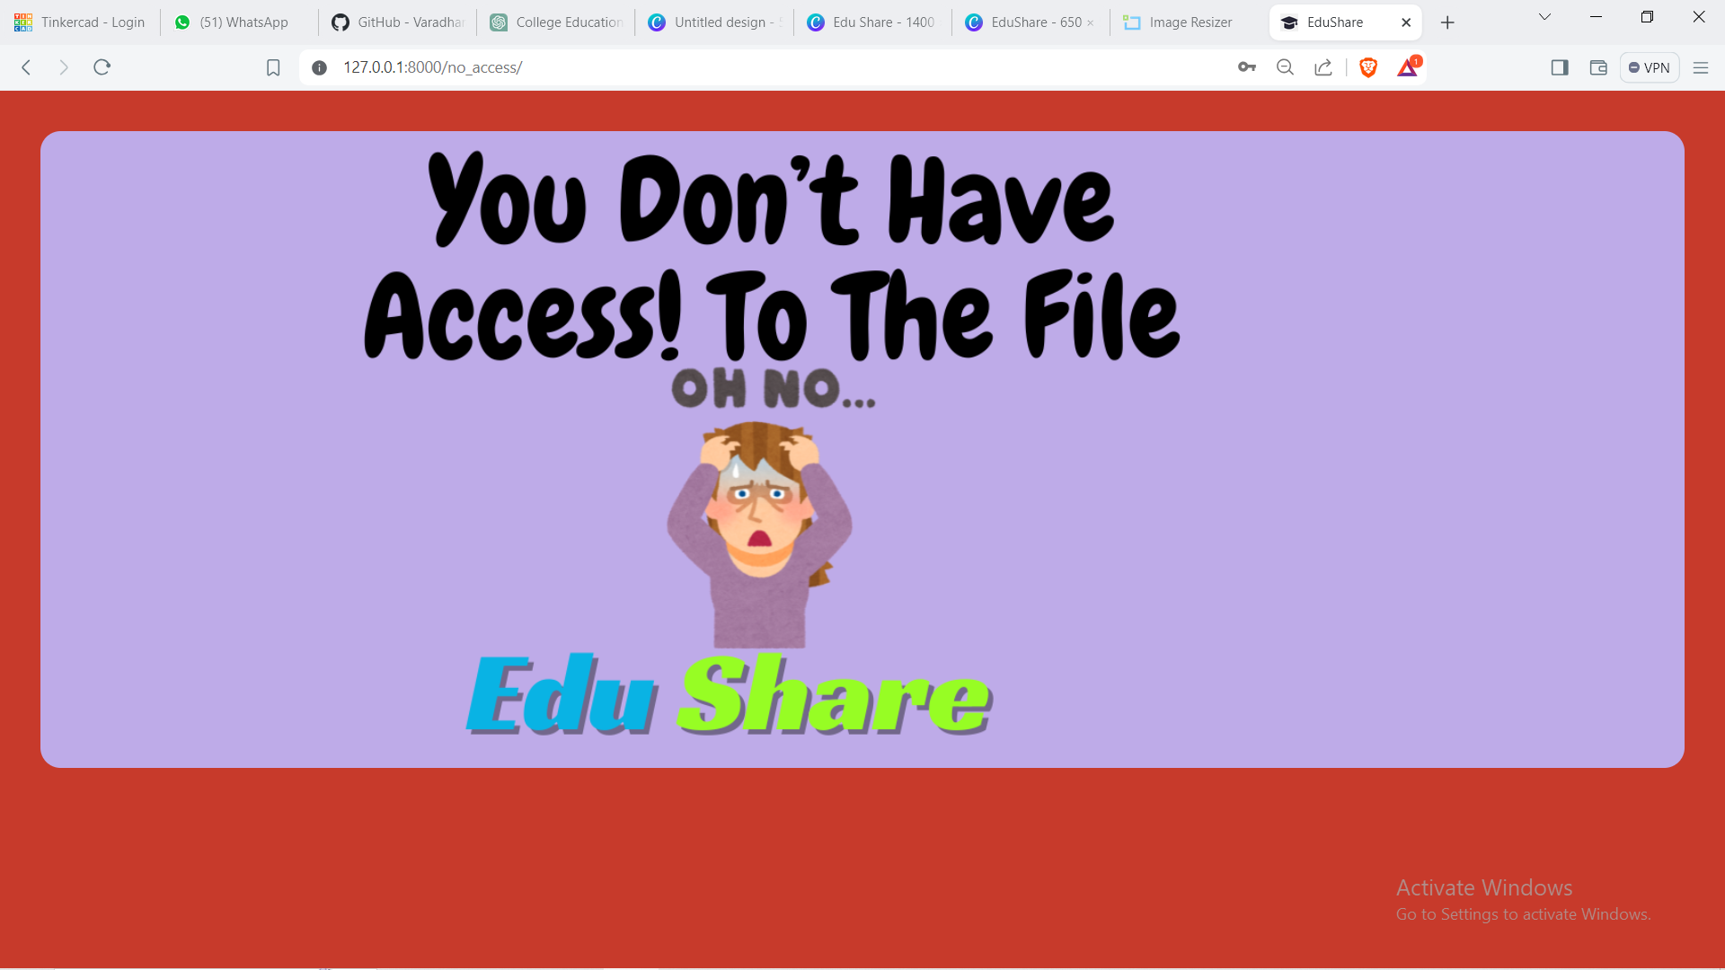
No access

Slide 14
Future Enhancements:
To continuously improve and expand the functionality of the secure file transfer web application built with HTML, CSS, JavaScript, Python, and Django, several future enhancements can be considered. These enhancements aim to enhance security, usability, and scalability based on user feedback and emerging technology trends.

Slide 15
Conclusion
In conclusion, the development of a secure file transfer web application using HTML, CSS, JavaScript, Python, and Django presents a robust solution for users seeking a reliable platform to manage and share files securely over the internet. Throughout this project, we've addressed key requirements, implemented essential features, and considered future enhancements to further improve the application.

Slide 16
Thank You!
Notes:
Thank You !!

